Slide 1
Basic Statistics
Saher Tabbasum

Slide 2
Outline
Getting Started with Data and Data Analysis
Getting to know the Data
Data Object, Attributes, Attribute Types
Measures of Central Tendency
Measures of Data Dispersion
Graphic Displays of Basic Statistical Descriptions
Conclusion

Slide 3
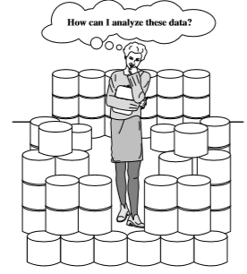
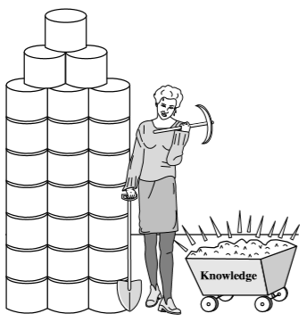
What is Data? Why Data Analysis?
Collection of facts, such as numbers, words, measurements, observations or just descriptions of things
Necessity, who is the mother of invention. – Plato
We are living in the data age
  Analyzing such data is an important need
Powerful and versatile tools are badly needed
  transform data into organized knowledge
  The world is data rich but information poor Searching for knowledge (interesting patterns) in data

Slide 4
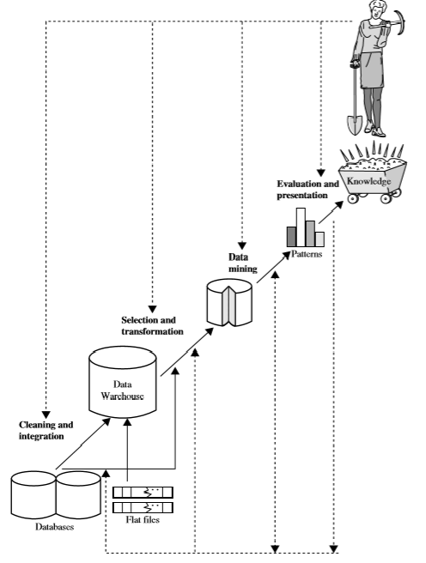
Knowledge Discovery Process

Slide 5


Types of Data Sets
Record
  Relational records
  Data matrix, e.g., numerical matrix, crosstabs
  Document data: text documents: term-frequency vector
  Transaction data
Graph and network
  World Wide Web
  Social or information networks
  Molecular Structures
Ordered
  Video data: sequence of images
  Temporal data: time-series
  Sequential Data: transaction sequences
  Genetic sequence data
Spatial, image and multimedia
  Spatial data: maps
  Image data
  Video data
Notes:
May we categorize data along the following dimensions?
- structured, semi-structured, and unstructured
- numeric and categorical
- static and dynamic (temporal?)
- by application

Slide 6
Getting to Know Your Data
Its tempting to jump straight into Data Analysis, but first, we need to get the data ready
  This involves a closer look at attributes and data values
Real-world data are typically noisy, enormous in volume (often several GBs or more), and may originate from heterogeneous sources
Concepts in coming slides are useful in getting familiar with your data
  Why to Get Familiar with Your Data???
    Knowledge about your data is useful for Data Preprocessing

Slide 7
Cont…
So what can we learn about our data that’s helpful in data preprocessing?
  Various Attribute Types
    Nominal, Binary, Ordinal, and Numeric
  Basic Statistical Descriptions of Data
    Measure of Central Tendency
    Measure of Dispersion
Benefits of knowing basic statistics regarding each attribute makes it:
  easier to ﬁll in missing values
  smooth noisy values
  spot outliers during data preprocessing
  help in ﬁxing inconsistencies incurred during data integration

Slide 8
Data Objects and Attributes
Data sets are made up of data objects
  A data object represents an entity
Data objects are typically described by attributes
Also called samples, examples, instances, data points, objects, data tuples Examples
  sales database: customers, store items, sales
  medical database: patients, treatments
  university database: students, professors, courses
An attribute is a data ﬁeld, representing a characteristic of a data object
Attribute can also be referred as dimension, feature, and variable
Examples
Customer Object - Customer_ID, name, address classify as attributes
Rows -> data objects Columns -> attributes

Slide 9
Cont…
Observed values for a given attribute are known as observations
A set of attributes used to describe a given object is called an attribute vector (or feature vector)
The distribution of data involving one attribute (or variable) is called univariate. A bivariate distribution involves two attributes, and so on.

Slide 10
Attribute Types
The type of an attribute is determined by the set of possible values
Two categories: Qualitative and Quantitative
Qualitative (descriptive information) attribute types:
  Nominal
  Binary
    Symmetric
    Asymmetric
  Ordinal
Quantitative (numerical information) attribute types:
  Numeric
    Interval-scaled
    Ratio-scaled
  Discrete
  Continuous

Slide 11
Nominal Attribute
Nominal means “relating to names”
The values of a nominal attribute are symbols or names of things
  Each value represents some kind of category, code, or state
  Can be represented with numbers but not treated quantitatively
There is no order (rank, position) among values of nominal attribute
Also referred as categorical attribute
Only mode can be calculated
Nominal Attribute | Values
Hair_colors | black, blond, brown, grey, red, white
Occupation | teacher, dentist, programmer, farmer
marital status | Single, married, divorced, widowed
ID numbers, zip codes, Customer_ID | 001, 002, 003

Slide 12
Binary Attribute
  A nominal attribute with only 2 states/categories (0 or 1)
  “0” typically means that the attribute is absent, and “1” means that it is present
  Binary attributes are referred to as Boolean if the two states correspond to “True” and “False”
  Symmetric : Both values are equally important. i.e. there is no preference on which outcome should be coded as 0 or 1
  Asymmetric : Both values are not equally important. By convention: assign 1 to most important outcome
Binary Attribute | Values
Gender | Male, Female
Binary Attribute | Values
COVID-19 Detection | Yes, No
Exam Result | Pass, Fail
Smoker | 1, 0

Slide 13
Ordinal Attribute
Values have a meaningful sequence or ranking (order) between them but magnitude between successive values is unknown
  i.e. the order of values shows what is important but don’t indicate how important it is
Example
Mode and median can be calculated
Ordinal Attribute | Values
Size | Small, medium, large
Grades | C, B, B+, A, A+
Army Ranking | Captain, Major, Colonel
Professional Ranking | Assistant, Associate, Full
0: very dissatisﬁed | 1: somewhat dissatisﬁed | 2: neutral | 3: satisﬁed | 4: very satisﬁed

Slide 14
Numeric Attribute
Numeric attribute is quantitative in nature
  a measureable quantity represented in integer or real-values
Numeric attributes types;
  Interval-scaled
  Ratio-scaled
Interval-scaled
  Measured on a scale of equal-size units
  Values have order and can be positive, 0, or negative
  No true zero-point
  Central tendency (mean, median, mode) measures can be computed
Examples
temperature in C˚or F˚, calendar dates
  If one day temperature is twice than the other day we cannot say that one day is twice as hot as another day

Slide 15
Cont…
Ratio-scaled
  Ordered values
  Inherent zero-point
  We can speak of values as being an order of magnitude larger than the unit of measurement (10 K˚ is twice as high as 5 K˚).
  Difference between values can be calculated
  Central tendency (mean, median, mode) measures can be computed
  Quantile-range and Five number summary can be given
Examples
temperature in Kelvin, length, count attributes (e.g. years of experience), monetary quantities, attributes to measure weight, height, latitude and longitude coordinates

Slide 16
Discrete vs. Continuous Attributes
Discrete Attribute
  Has only a finite or countably infinite set of values
    E.g., zip codes (30125, 54214), profession (teacher, businessman, peon), or the set of words in a collection of documents
  It can be numerical and can also be in categorical form
  Note: Binary attributes are a special case of discrete attributes
Continuous Attribute
  Has real numbers (infinite no of states) as attribute values
    E.g., temperature, height (5.4, 5.6,…etc.), or weight (64.5, 66.3,…etc.)
  Practically, real values can only be measured and represented using a finite number of digits i.e. as floating-point variables

Slide 17
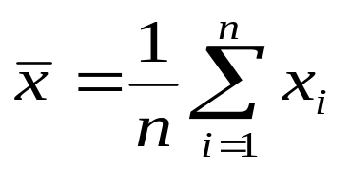

Measures of Central Tendency
Arithmetic Mean
  Numeric measure of the “center” of a data set for a Numeric attribute.
  Where x_{i} (1,2,…n) is a set of “n” observed values or observations for x (numeric attribute) e.g. Salary
Weighted Mean/Weighted Average
  Used when we consider some data values to be more important than other values, and so, we want them to contribute more to the final "average“
  The weights reﬂect the signiﬁcance, importance, or occurrence frequency attached to their respective values

Slide 18
Cont…
Problem with Mean
  Sensitive to extreme values (outliers). Even a small number of extreme values can corrupt the mean
To offset the effect caused by these extreme values, use trimmed mean
  Sort data set and chop values at the high and low extremes
  How much to chop?? 2%
Which is the better measure for skewed (asymmetric) data?
  Median
    Middle value in a set of ordered data values (odd number data set)
    Average of the middle two values (even number data set)
    Applies to numeric data, but can be extended to ordinal data

Slide 19
Cont…
Mode
  Value that occurs most frequently in the data set
  Can be determined for both qualitative and quantitative attributes
  Unimodal (one mode), bimodal (two modes), trimodal (three modes), multimodal (two or more modes)
  If each data value occurs only once, then there is no mode
  For unimodal numeric data that are moderately skewed (asymmetrical), we have the following empirical relation:
  Implies that mode can easily be approximated if the mean and median values are known

Slide 20



Symmetric vs. Skewed Data
Plotting the measures of central tendency (mean, median, mode) for unimodal frequency curves, shows us if the data are symmetric or skewed (positively or negatively)
  Data in most real applications are not symmetric
Quantile plots, histograms, and scatter plots are other graphic displays of basic statistical descriptions
positively skewed
(mode < median < mean)
negatively skewed
(mode > median > mean)
symmetric (Normal Distribution)
mean = median = mode

Slide 21
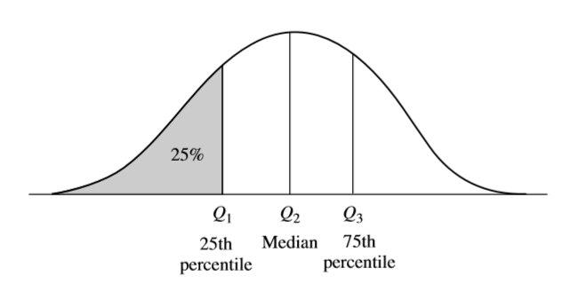
Measuring the Dispersion of Data
Percentiles: 100- quantiles – mostly known an quartiles
Quartiles: Q₁ (25th percentile), Q₂ (median), Q₃ (75th percentile)
Inter-quartile range: IQR = Q₃ – Q₁
A plot of the data distribution for some attribute X. The quantiles plotted are quartiles. The three quartiles divide the distribution into four equal-size consecutive subsets. The second quartile corresponds to the median.

Slide 22
Cont…
Example
Suppose we have the following values for salary (in thousands of dollars), shown in increasing order:
30, 36, 47, 50, 52, 52, 56, 60, 63, 70, 70, 110
Total 12 observations
Quartiles
  Third = $47,000 (Q1)
  Sixth = $52,000 (Median – two medians)
  Ninth = $93,000 (Q3)
  IQR= 63−47= $16,000

Slide 23
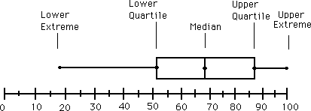
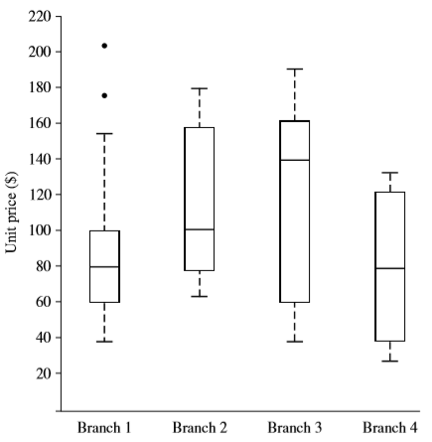
Cont…
Five-number summary of a distribution
  Minimum, Q1, Median, Q3, Maximum
Boxplots
  Popular way of visualizing a distribution
  A boxplot incorporates the ﬁve-number summary as follows:
    ends of the box are at the quartiles so that the box length is the interquartile range.
    The median is marked by a line within the box
    Two lines (called whiskers) outside the box extend to the smallest (Minimum) and largest (Maximum) observations.
Outliers
  usually, a value higher/lower than 1.5 x IQR

Slide 24


Cont…
Variance and standard deviation (sample: s, population: σ)
  Variance: (algebraic, scalable computation)
  Standard deviation s (or σ) is the square root of variance s² ⁽or σ²⁾
    σ measures spread about the mean
    σ > 0
      A low σ means that the data observations tend to be very close to the mean
      A high σ means that the data are spread out over a large range of values
    σ =0 only when there is no spread, that is, when all observations have the same value

Slide 25
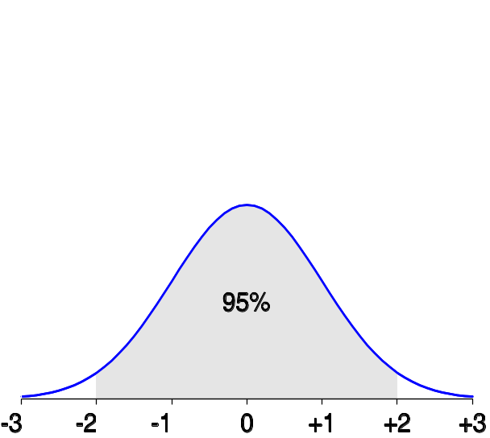
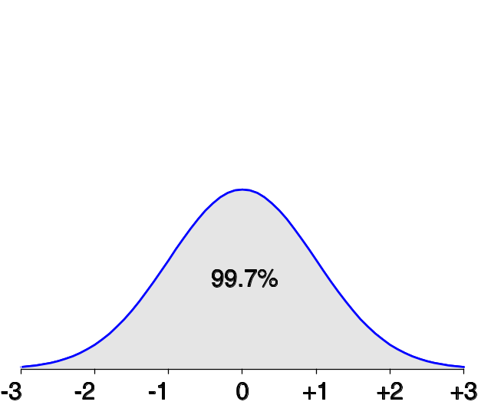
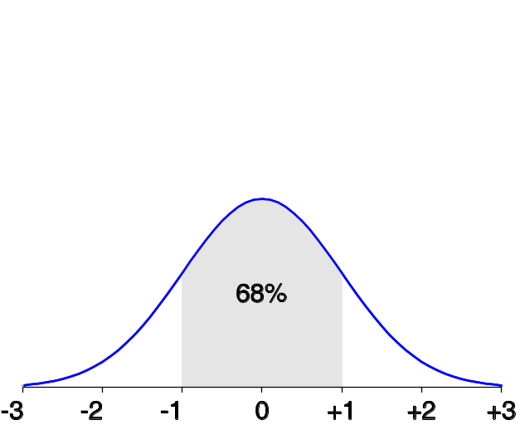
Properties of Normal Distribution Curve
The normal (distribution) curve
  From μ–σ to μ+σ: contains about 68% of the measurements (μ: mean, σ: standard deviation)
  From μ–2σ to μ+2σ: contains about 95% of it
  From μ–3σ to μ+3σ: contains about 99.7% of it

Slide 26
Graphic Displays of Basic Statistical Descriptions
Boxplot: graphic display of five-number summary
Histogram: x-axis are values, y-axis are frequencies
Quantile plot: each value x_{i} is paired with f_{i} indicating that approximately 100 f_{i} % of data are ≤ x_{i}
Scatter plot: each pair of values is a pair of coordinates and plotted as points in the plane
Notes:
JH: Maybe we can remove Loess curve

Slide 27
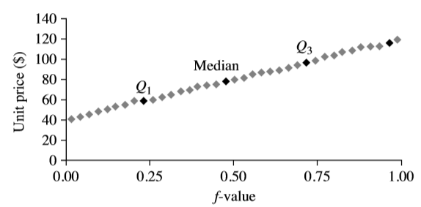

Quantile Plot
simple and effective way to have a ﬁrst look at a univariate data distribution
  First, displays all of the data for the given attribute (allowing the user to assess both the overall behavior and unusual occurrences)
  Second, it plots quantile information
  Each observation ,x_{i}, is paired with a percentage ,f_{i}, which indicates that approximately f_{i}×100% of the data are below the value, x_{i}
  allows us to compare different distributions based on their quantiles

Slide 28

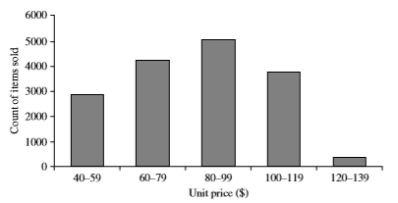
Histogram
Summarize the distribution of a given attribute X
  display of tabulated frequencies, shown as bars/poles
It shows what proportion of cases fall into each of several categories
Differs from a bar chart (nominal X) in that it is the area of the bar that denotes the value, not the height as in bar charts, a crucial distinction when the categories are not of uniform width (range)
The categories are usually specified as non-overlapping intervals of some variable. The categories (bars) must be adjacent
For example, a price attribute with a value range of $1 to $200 can be partitioned into subranges 1 to 20, 21 to 40, 41 to 60, and so on
Notes:
JH: A better and BASIC histogram figure --- because this one overlaps with a later one!

Slide 29
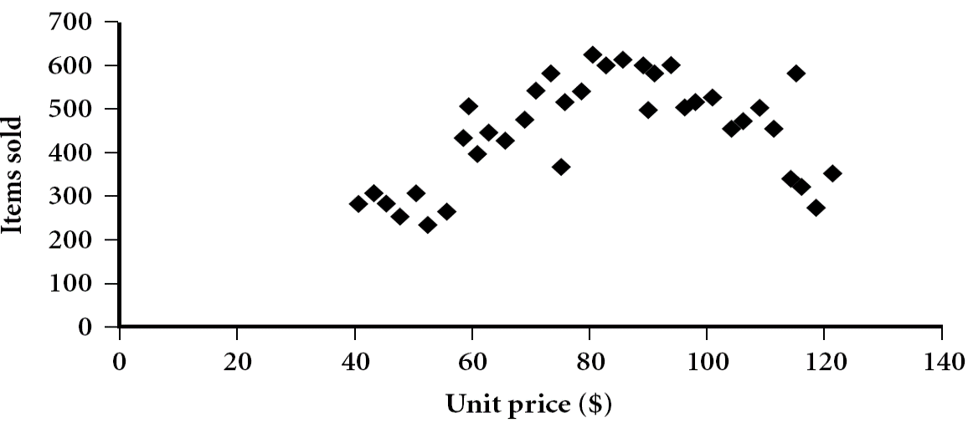
Scatter plots and Data Correlation
determines if there appears to be a relationship, pattern, or trend between two numeric attributes
  Provides a first look at bivariate data to see clusters of points, outliers, or to explore the possibility of correlation relationships
    Two attributes, X, and Y, are correlated if one attribute implies the other
    Correlations can be positive, negative, or null (uncorrelated).
Each pair of values is treated as a pair of coordinates and plotted as points in the plane
Notes:
Need a better and more MEANINGFUL scatter plot! -JH

Slide 30


Positively and Negatively Correlated Data
positively correlated (values of X increase as the values of Y increase)
negatively correlated (values of X increase as the values of Y decrease)

Slide 31


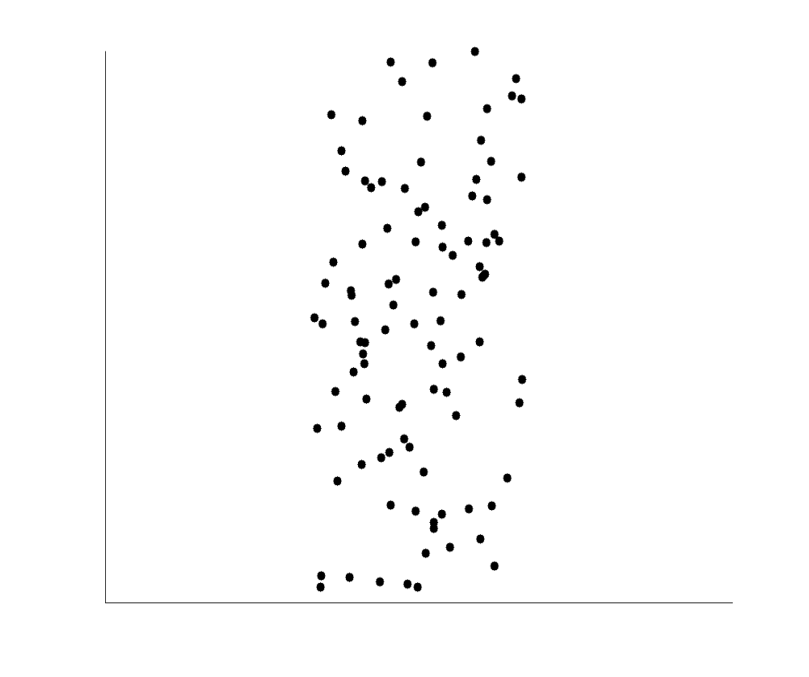
Uncorrelated Data
3 cases for which there is no correlation relationship between the two attributes in each of the given data sets

Slide 32
Conclusion
Basic data descriptions (e.g., measures of central tendency and measures of dispersion) and graphic statistical displays (e.g., quantile plots, histograms, and scatter plots) provide valuable insight into the overall behavior of your data.
They help to identify noise and outliers, especially useful for data cleaning

